Slide 1
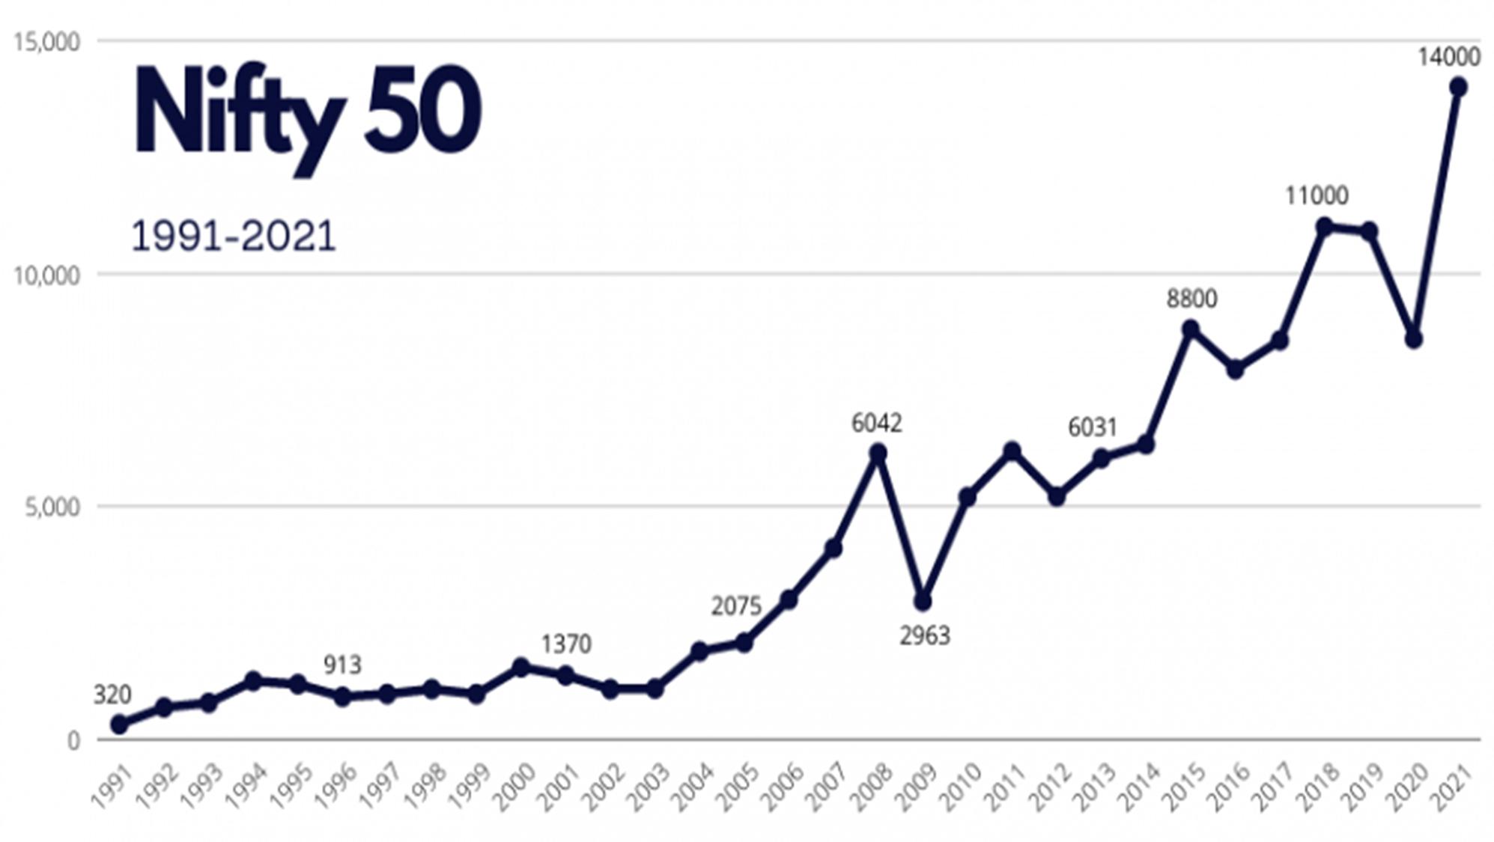

Investment Advisor
Nifty-50
Stock Prediction
Presented By
Brajesh V Kulkarni
Kaustubh Chitte
Md. Kamran
Sumidha Kumari Prasad
Vishal Chauhan

Slide 2
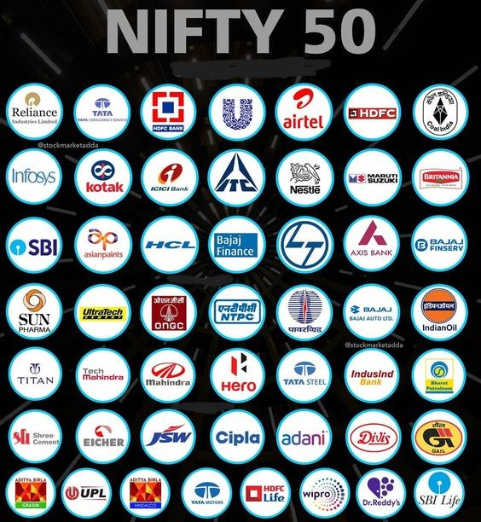
What is Nifty 50?
Nifty 50 Companies
Nifty 50 is a stock market index in India, representing the performance of the top 50 companies traded on the National Stock Exchange (NSE).
It reflects the health of India's economy by tracking the share prices of these prominent companies, making it a key indicator for investors and analysts.

Slide 3
The Significance of Stock Price Prediction
Predicting stock prices is important for Investors, allowing them to make informed decisions about buying or selling stocks, potentially maximizing profits.
Traders rely on predictions for quick buying and selling, aiming to capitalize on short-term market movements.
Financial Analysts use predictions to provide valuable insights to clients, helping them plan for the future.
Challenges and Uncertainties:
Stock markets are highly volatile and subject to numerous factors, including economic events, politics, and investor sentiment.
We can not time the market.

Slide 4
Data Extraction:
We scrapped data from the website for the last 4 Years
With help of Webdriver and Beautiful Soup Libraries
Gsheet Integration
Integrating Python with Google Sheets involves API integration, allowing seamless data exchange between Python scripts and Google Sheets, providing an alternate, efficient method for real-time data interactions and automation.
Modelling:
The machine learning model employs polynomial regression to forecast profit/loss in Nifty 50 stocks, capturing nonlinear relationships between features and stock price movements for more accurate predictions.
Data preprocessing:
It involved cleaning and transforming raw data to make it suitable for model building. This step ensured data quality and made it compatible with our analysis.
Partial Web Page Developement:
Created static web page using HTML and CSS
Key Project Phases

Slide 5
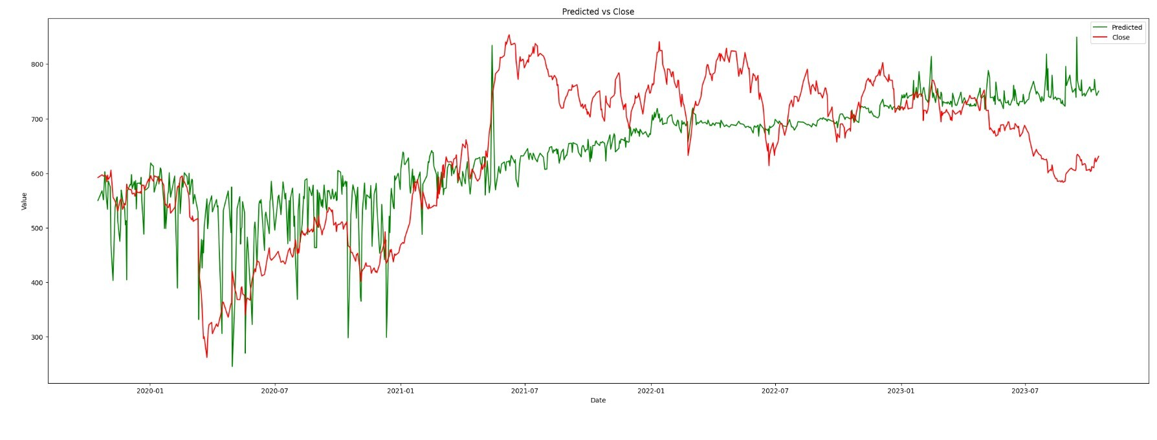
Model Building and Evaluation
Model is trained on 4 Years of Data
Oct 2019 – Oct 2023
The machine learning model chosen for stock price prediction is Polynomial Regression.
Key performance metrics used to evaluate the model's accuracy included
Mean Squared Error (MSE),
Root Mean Squared Error (RMSE),
R-squared (R2).

Slide 6
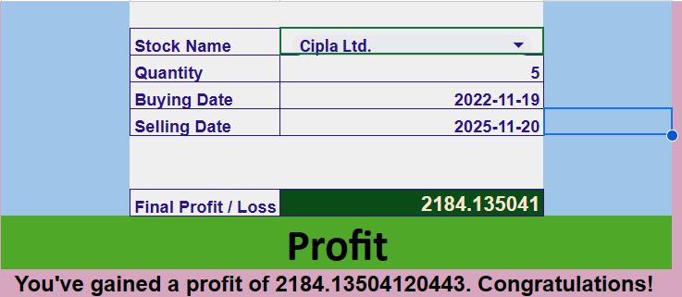
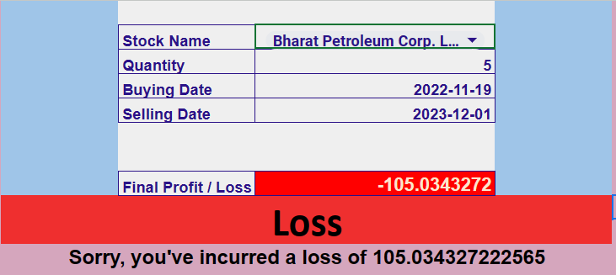
Result of Integrated Machine Learning model with help of Google Sheet
Integration with Google Sheets through the Google Sheets API enabled effortless user interaction with our stock prediction model.
Users can input stock details
(Stock Name, Quantity, Buying Date, Selling Date)
directly within Google Sheets, simplifying the prediction process.
Link: Nifty50 Stock Price Prediction - Google Sheets

Slide 7
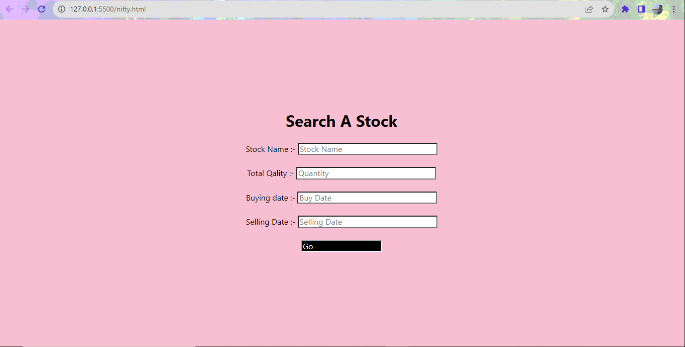
Web Page
Created Partial Web Page with HTML and Embedded CSS
Here we created a basic web page with help of HTML and CSS, but we faced difficulties while
Integrating it with our model and dataset

Slide 8
Challenges and Learnings
Web Scraping & Data Collection:
Ensuring consistent and reliable data extraction from website, dealing with changes in page structure, and handling rate limiting issues.
Model Building for 50 Stocks:
Developing, training, and managing individual models for stocks in Nifty 50
Integrating Google Sheets:
Integrating Python model with Google Sheets for user-friendly input and output
Creating a Dynamic Webpage
Designing an interactive and dynamic webpage for user interaction and visualization of predictions.
Time Management:
Effectively managing time throughout the project, balancing various tasks such as data collection, model building, integration, and webpage development within project deadlines.

Slide 9
Thank You

